Slide 1

Discovering Toronto Neighborhoods
Amos Chew - N01533575
Ricardo Hornedo - N01538048
WenHao Fang - N01555914

Slide 2
When you first came to Canada, How did you pick a place to stay?

Slide 3

Problem Statement:
As Toronto's population continues to grow, it's crucial for the Toronto Police Service to understand and track major crimes in the city. There's a clear need to analyze this data to pinpoint where most crimes occur.

Slide 4
Introduction & Objectives
Identify the times when most crimes occur.
Determine the specific areas in Toronto with higher crime rates.
Understand the most common types of crimes in these areas.

Slide 5
Data Source and Logical Model Design - Data Source
Major Crime Indicator is the dataset about crime occurrences provided by the city of Toronto's open data:
Features:
Official Toronto Police data source.
Covers major crime categories in Toronto.
Contains historical data since 2014.

Slide 6
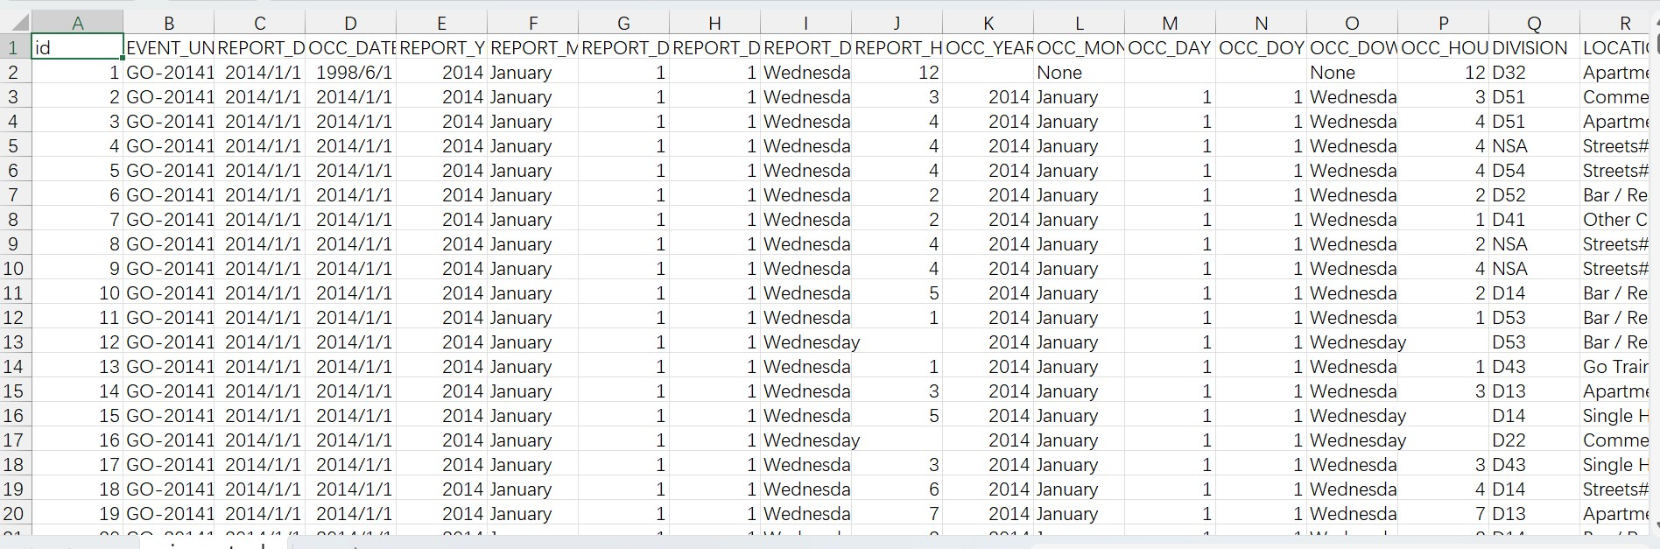
Data Source and Logical Model Design - Data Source
Precisely, our dataset is a CSV file that has 323296 rows of major crime data across 158 City of Toronto neighborhoods.

Slide 7
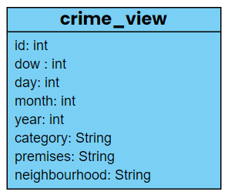
Data Source and Logical Model Design - Logical Model Design
For ease of analysis, we selected 7 out of 27 columns to build our logical model and designed our crime_view model as follows.

Slide 8
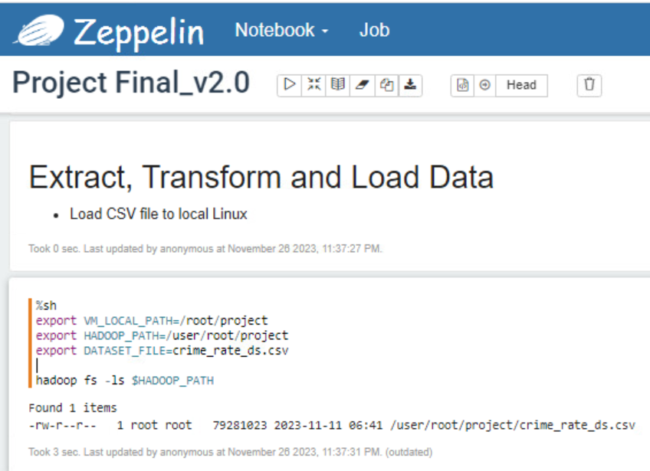
The Implementation of the Logical Model
To implement our warehouse model, we leverage Hadoop, a powerful big data technology, to harness the benefits of distributed storage and processing.
Placing our CSV file into Hadoop ensures scalability, fault tolerance, and efficient data handling.

Slide 9
The Implementation of the Logical Model
Utilized Hive for robust database infrastructure
Created crime_rate_ext external table for direct CSV file reference
Developed crime_rate_orc internal table for data processing
crime_view central for in-depth analysis

Slide 10
In Depth Analysis
and Findings

Slide 11
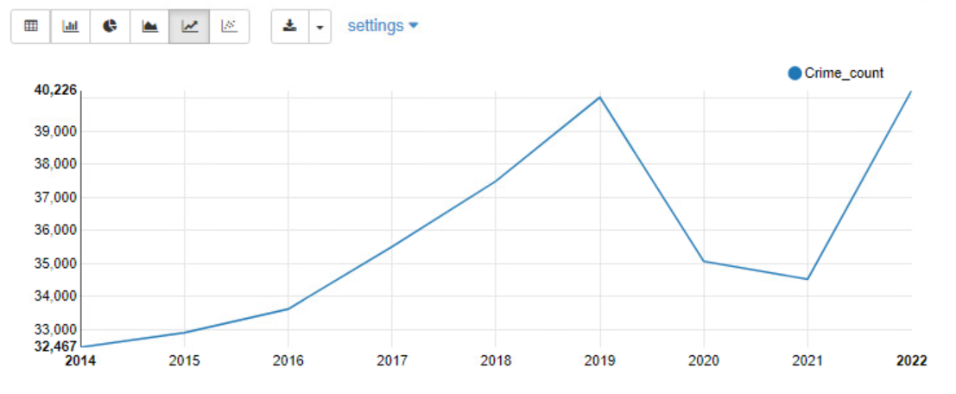
Temporal Analysis - General Trend
Toronto's annual crime trends (2014-2022) show dynamic fluctuations.
Beginning at 32,467 incidents in 2014, the rate steadily rose to a peak of 40,026 in 2019.
Subsequent years saw declines in 2020 and 2021, followed by a sudden rise to 40,225 incidents in 2022.

Slide 12
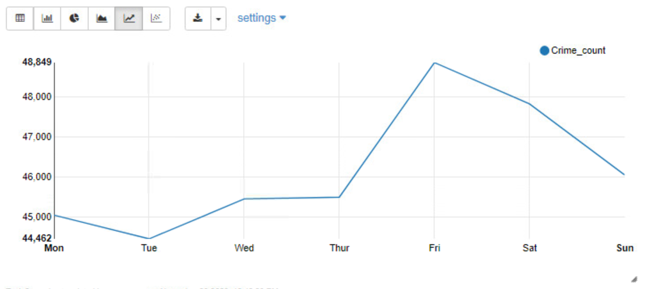
Temporal Analysis - Day of Week
Line chart shows elevated crime counts on Friday, Saturday, and Sunday.
Fridays consistently have the highest numbers, while Tuesdays consistently have the lowest.

Slide 13
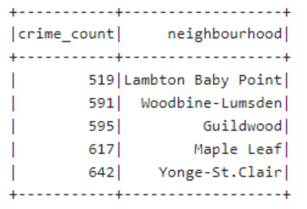
Geographic Analysis - Top 5 Region with Lowest Crime
“Location, location, location!” - A mantra in real estate underscores the significance of geography.
Using Spark in Zeppelin, we identified the top 5 regions with the lowest crime numbers, offering insights into safer areas.
The output reveals that Lambton Baby Point has the lowest crime number at 519, followed by Woodbine-Lumsden, Guildwood, Maple Leaf, and Yonge-St.Clair.

Slide 14
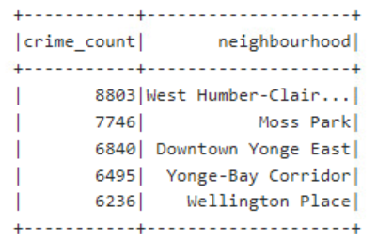
Geographic Analysis - Top 5 Region with Highest Crime
The output highlights West Humber-Clair as the neighbourhood with the highest crime number at 8,803, followed by Moss Park, Downtown Yonge East, Yonge-Bay Corridor, and Wellington Place.
Notably, West Humber-Clair, the neighbourhood with the highest crime number, is home to Humber College (North Campus).

Slide 15
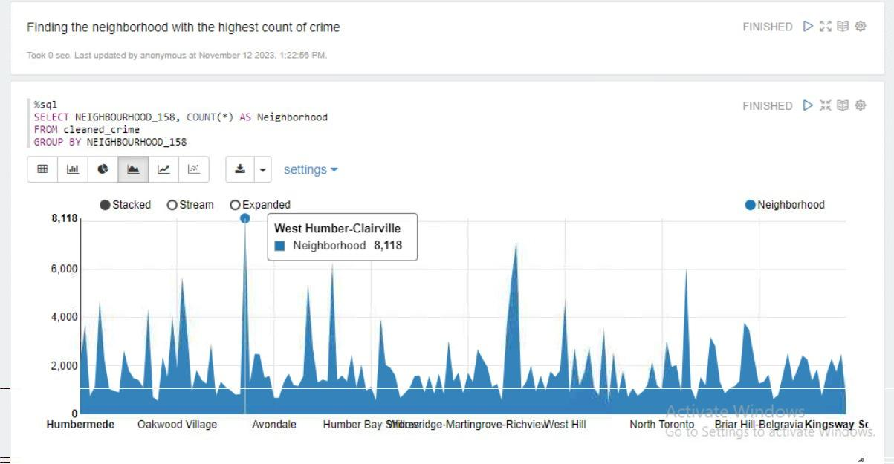
IDENTIFYING HIGH CRIME RATES

Slide 16
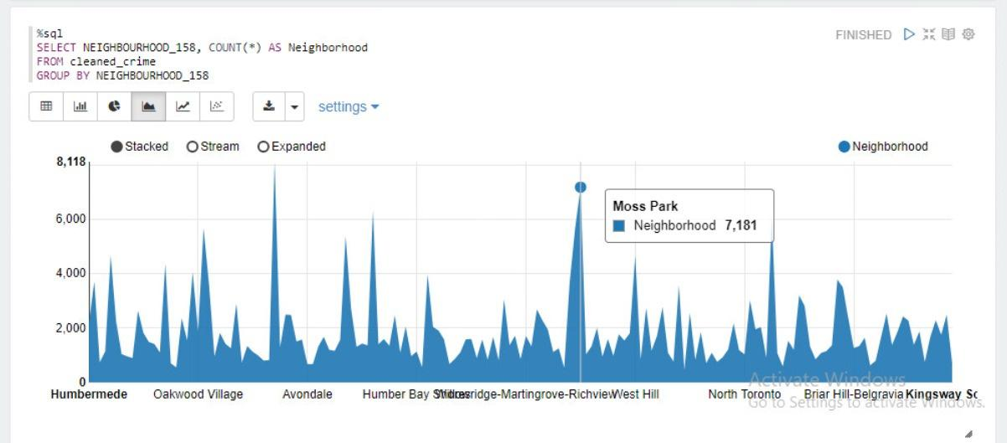
IDENTIFYING HIGH CRIME RATES

Slide 17
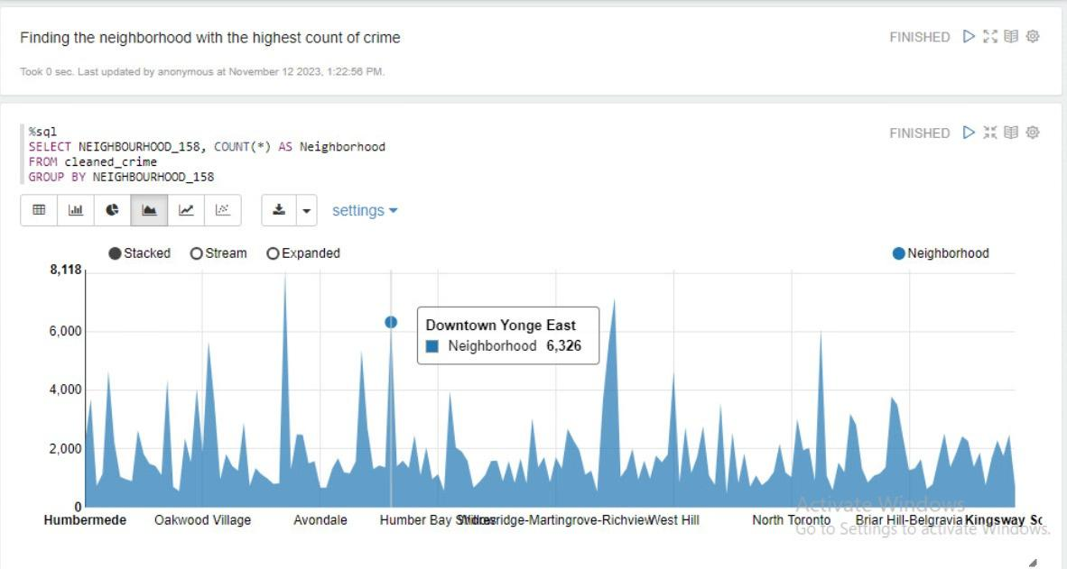
IDENTIFYING HIGH CRIME RATES

Slide 18
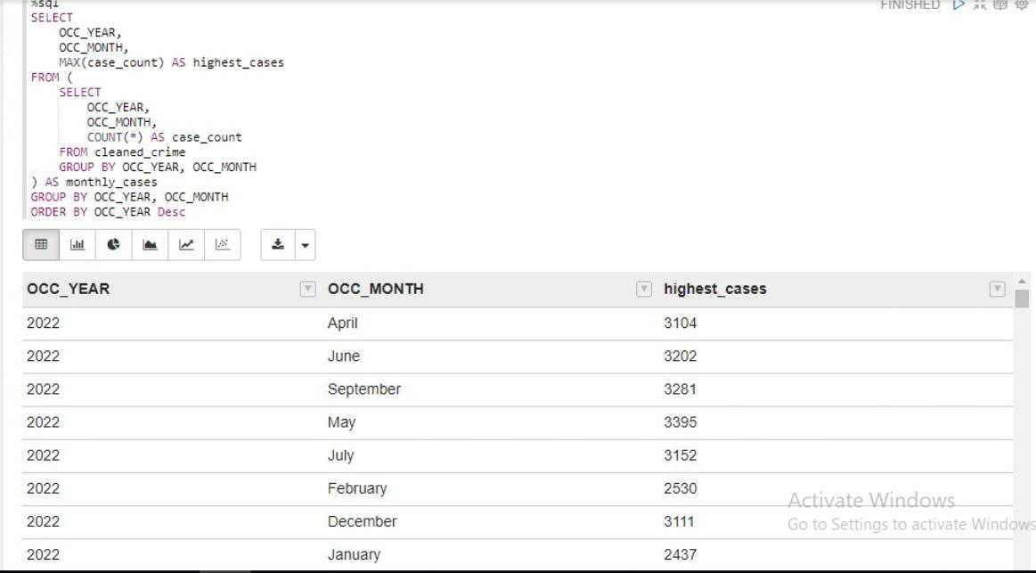
UNVEILING TORONTO’S LANDSCAPE

Slide 19
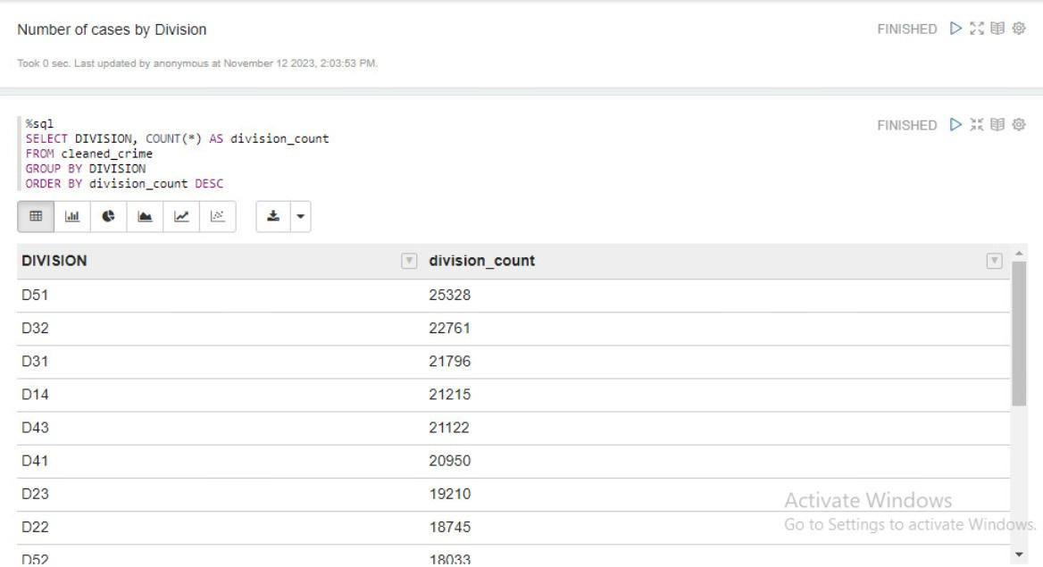
UNVEILING TORONTO’S LANDSCAPE

Slide 20
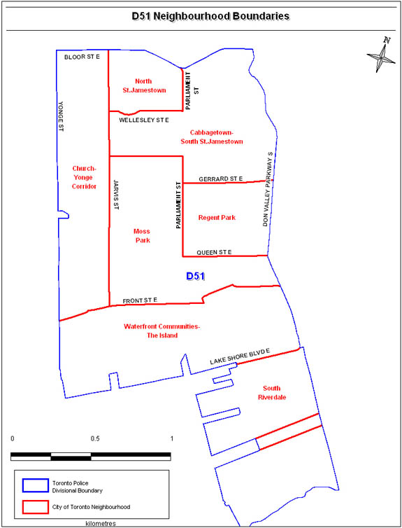
UNVEILING TORONTO’S LANDSCAPE

Slide 21
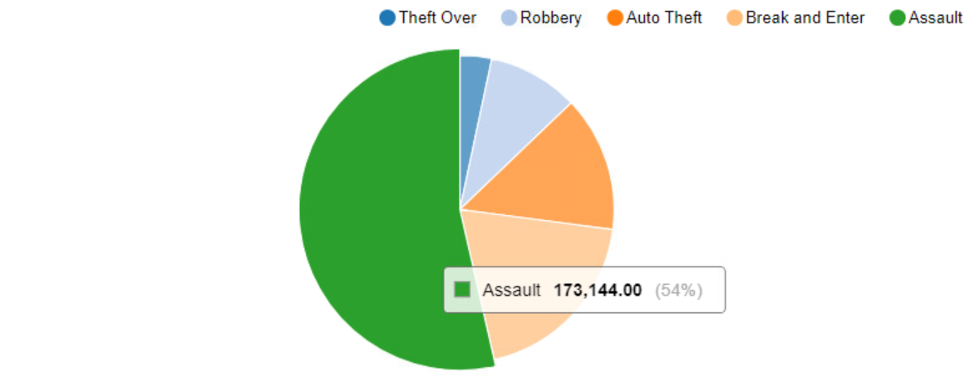
Pattern Analysis - Crime Category Analysis
Assault is the predominant crime, representing 54% of incidents, followed by Break and Enter at 19%, and Auto Theft at 14%.

Slide 22
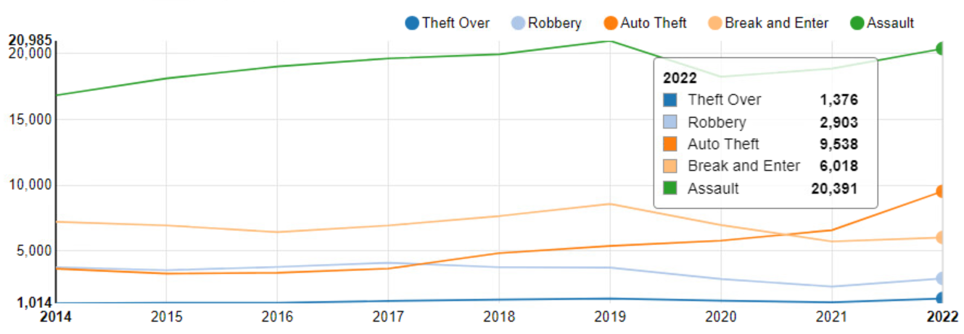
Pattern Analysis - Crime Category Analysis
As shown below, all types of crime numbers rise in 2022, and auto theft has increased significantly in recent years, exceeding the Break and Entry in 2021 and becoming the second major crime.

Slide 23
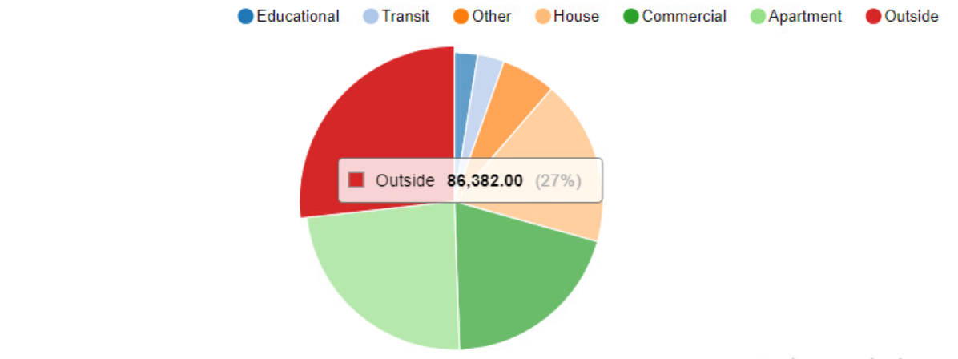
Pattern Analysis - Premises Categories
The analysis result indicates a distribution in crime locations, with incidents occurring outside comprising 27%, closely followed by apartments at 24%, commercial areas at 20%, and houses at 18%.

Slide 24
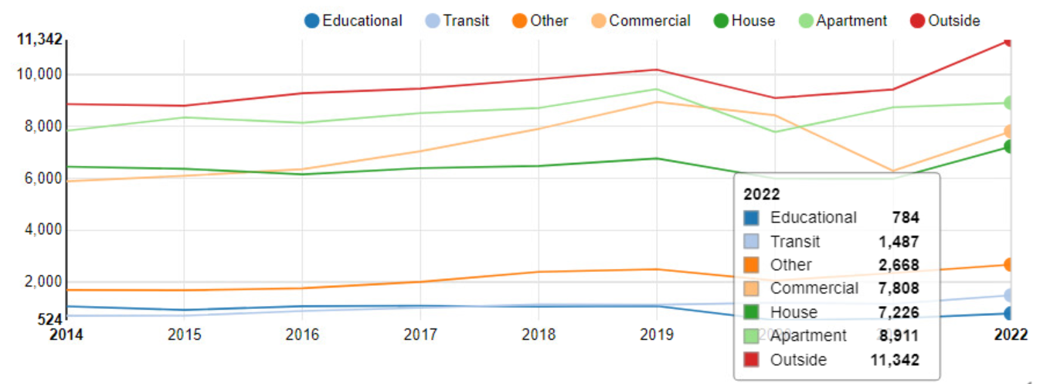
Pattern Analysis - Premises Categories
Furthermore, when examining year-to-year premises, there was a notable increase in incidents in outside locations, commercial areas, and houses, especially in 2022.
%sql
SELECT
COUNT(*) AS crime_count,
premises,
year
FROM crime_view
WHERE year >= 2014
GROUP BY
year, premises
ORDER BY
crime_count, premises DESC

Slide 25
Practical Utilization
Optimizing Law Enforcement Resources: Direct resources to high-crime areas for effective crime reduction.
Housing Market Insights: Use crime data for housing market evaluations, emphasizing neighbourhood safety.
Tailored Security Strategies: Develop customized security plans based on crime analysis for different premises types.

Slide 26
Conclusions
Utilized big data technologies (Hadoop, Hive, Spark, Zeppelin) for analyzing major crimes in Toronto City.
Temporal Analysis: Observed dynamic annual crime trends from 2014 to 2022 and distinct weekly patterns with Fridays consistently having the highest crime counts.
Geographic Analysis: Humber College, North Campus is located in the most dangerous neighbourhood.

Slide 27
Conclusions
Pattern Analysis: Assault emerged as the dominant crime, accounting for 54% of incidents. Premises analysis revealed crime distribution across outside locations, apartments, commercial areas, and houses.
Our analysis provides a strategic roadmap, empowering:
Law Enforcement: Targeted resource allocation for effective crime control.
Housing Market Decisions: Informed choices considering safety.
Security Strategies: Customized plans for various premises types.

Slide 28

Thank you!

Slide 29
Back up Slides

Slide 30
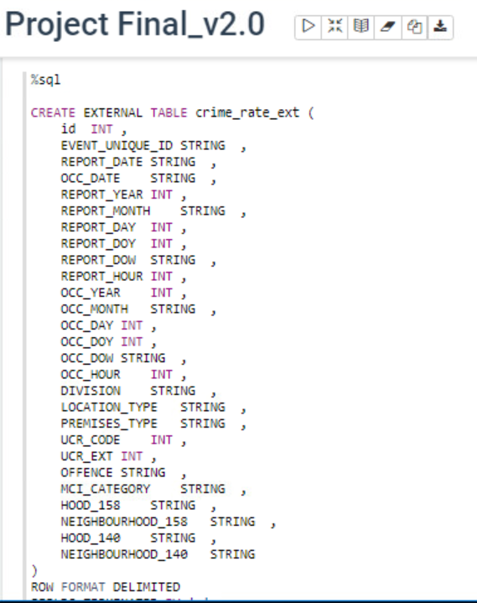
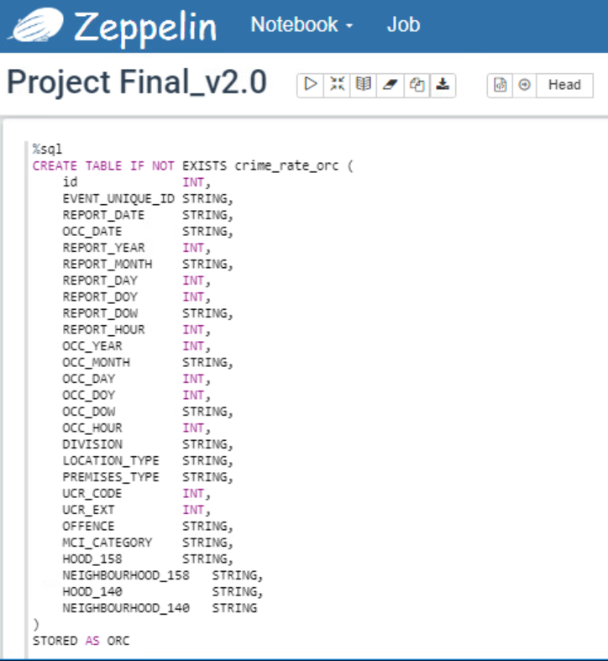
The Implementation of the Logical Model

Slide 31
Temporal Analysis - Day of Week
Analyzing the crime patterns by day of the week, we executed a query to compute the total number of crimes for each day and visualized the findings in a line chart.
%sql
SELECT
dow AS Day_of_Week,
CASE dow
WHEN 0 THEN 'Mon'
WHEN 1 THEN 'Tue'
WHEN 2 THEN 'Wed'
WHEN 3 THEN 'Thur'
WHEN 4 THEN 'Fri'
WHEN 5 THEN 'Sat'
ELSE 'Sun'
END
AS d_o_w,
COUNT(*) AS Crime_count
FROM crime_view
GROUP BY 1
ORDER BY 1 ASC

Slide 32
Geographic Analysis - Top 5 Region with Lowest Crime
“Location, location, location!” - A mantra in real estate underscores the significance of geography.
In this section, we explore how location influences crime distribution in Toronto City.
Using Spark in Zeppelin, we identified the top 5 regions with the lowest crime numbers, offering insights into safer areas.
%spark2
val df_low_region = spark.sql("SELECT COUNT(*) AS crime_count, neighbourhood FROM crime_view GROUP BY neighbourhood ORDER BY crime_count ASC LIMIT 5")
df_low_region.show()

Slide 33
Geographic Analysis - Top 5 Region with Highest Crime
Using Spark, we queried the top 5 regions with the highest crime numbers, revealing the riskiest neighbourhoods in Toronto City.
%spark2
val df_highest_region = spark.sql("SELECT COUNT(*) AS crime_count, neighbourhood FROM crime_view GROUP BY neighbourhood ORDER BY crime_count DESC LIMIT 5")
df_highest_region.show()

Slide 34
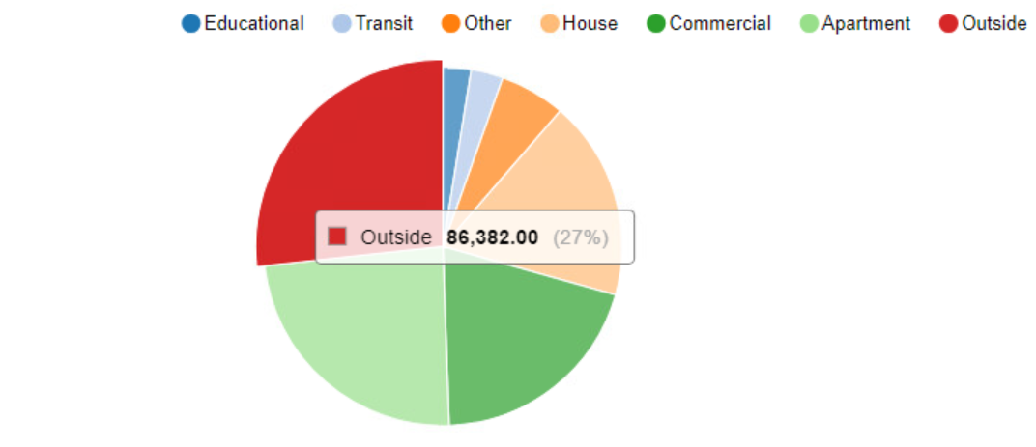
PREMISES

Slide 35
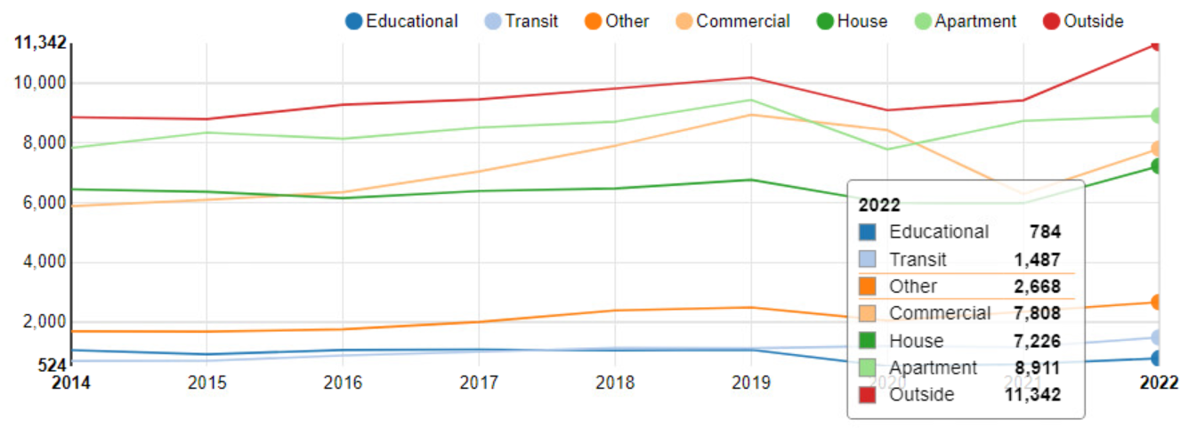
PREMISES

